Slide 1
Caption Generator
Guide Name: Dr. S Thenmozhi Vijaykumar R Pai
Associate Professor, Dept. of CA PES1201702013
PES University

Slide 2
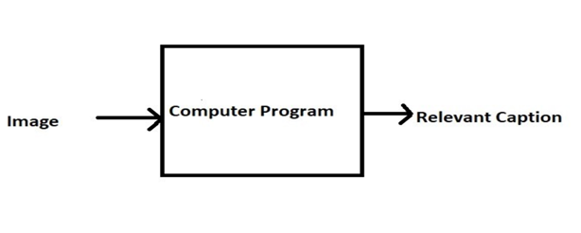
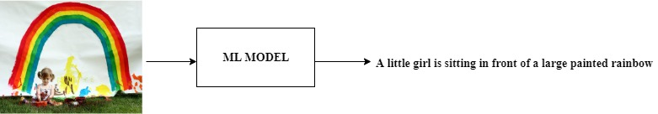
ABSTRACT
Caption Generator is a Machine Learning application which identifies the action portrayed in the given image.
The generated caption will describe about the image which will say what kind of actions is taking place in it.

Slide 3
INTRODUCTION
You saw an image and your brain can easily tell what the image is about, but can a computer tell what the image is representing?
With the advancement in Deep learning techniques and availability of huge datasets and computer power, it is possible to build models that can generate captions for an image.
This project involves Computer Vision and Natural Language Processing concepts to recognize the context of an image and describe them in a natural language like English.
The objective of the project is to build a working model of Caption Generator by implementing CNN with LSTM.
The basic working of the application is that the features are extracted from the images using pre-trained VGG16 model and then fed to the LSTM model along with the captions to train.
The trained model is then capable of generating captions for any images that are fed to it.

Slide 4
LITERATURE SURVEY
Existing Systems
Captionbot.ai
It is a product of Microsoft.
It is an ML application which can understand the content of any image.
When a person upload a photo, it is sent to Microsoft for image analysis to return a caption
The application will not store or publish the images anywhere.
It uses Computer Vision API and Emotion API
How-Old.net
It is also a product of Microsoft.
It estimates the age of the person in the given image.
The age is generated as a caption
TwinsOrNot.net
It identifies whether the image has twins or not

Slide 5

LITERATURE SURVEY
Research Papers
Title: Automatic Description Generation from Images: A Survey of Models, Datasets, and Evaluation Measures
Author: Raffaella Bernardi, Ruket Cakici, Desmond Elliott, Aykut Erdem, Erkut Erdem, Nazli Ikizler-Cinbis, Frank Keller, Adrian Muscat, Barbara Plank
Publication: Cornell University
Summary: Here in this paper, the authors have described their project as a challenging problem as the model was not working properly with natural images that have recently received a large amount of interest from the computer vision and natural language processing communities. Also, they have classified the existing approaches based on how they conceptualized this problem. They provided a detailed review of existing models, highlighting their advantages and disadvantages.

Slide 6
Title: An Empirical Study of Language CNN for Image Captioning
Author: Jiuxiang Gu, Gang Wang, Jianfei Cai, Tsuhan Chen
Publication: 2017 IEEE International Conference on Computer Vision
Summary: In this paper, effectiveness of their approach is validated on two datasets: Flickr30K and MS COCO. The extensive experimental results show that their method outperforms the vanilla recurrent neural network based language models and is competitive with the state-of-the-art methods.

Slide 7
Title: A Comprehensive survey of Deep Learning for Image Captioning
Author: MD. Zakir Hossain, Ferdous Sohel, Mohd Fairuz Shiratuddin, Hamid Laga
Publication: Murdoch University, Australia
Summary: In this paper, Although deep learning-based image captioning methods have achieved a remarkable progress in recent years, a robust image captioning method that is able to generate high quality captions for nearly all images is yet to be achieved.

Slide 8
Title: What is the Role of Recurrent Neural Networks (RNNs) in an Image Caption Generator?
Author: Marc Tanti, Albert Gatt, Kenneth P. Camilleri
Publication: Cornell University
Summary: In this paper, a recurrent neural network (RNN) is typically viewed as the primary `generation' component. This view suggests that the image features should be `injected' into the RNN. This is in fact the dominant view in the literature. Alternatively, the RNN can instead be viewed as only encoding the previously generated words. This view suggests that the RNN should only be used to encode linguistic features and that only the final representation should be `merged' with the image features at a later stage. This paper compares these two architectures. We find that, in general, late merging outperforms injection, suggesting that RNNs are better viewed as encoders, rather than generators.

Slide 9
TOOLS AND TECHNOLOGIES
Frontend: HTML, CSS, Bootstrap
Backend: Flask 1.x
Language: Python 3.7
Storage (Dataset): Google Drive
IDE: Jupyter Notebook

Slide 10
Functionalities
User Perspective
User launches the application.
User uploads the images for which the captions are to be generated.
User clicks on the submit button.
Within a matter of seconds, the ML model recognizes and process the content of an image.
The result will be displayed on the page.

Slide 11
Functionalities
Model Development and Deployment
Data Gathering
Images for training the model
Corpus for Image captions
Pre-processing
Corpus – Removal of stop words, punctuation marks, digits
Generating the bag of words
Mapping of images with the Corpus
Feature extraction from images
Object identification
Model Generation using CNN
Building LSTM (Long Short Term Memory) model.
Validating the Model
Deploy the ML model in the web application

Slide 12
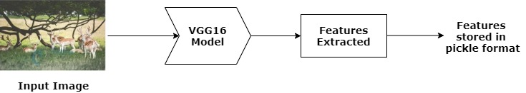
DETAILED METHODOLOGY
How Images are Pre-Processed
CNN model could be used directly as part of a broader image caption model. The problem is, it is a large model and running each photo through the network every time we want to test a new language model configuration is redundant. Instead, we can pre-compute the “photo features” using the pre-trained model and save them to file. We can load these features later and feed them into our model as the interpretation of a given photo in the dataset. It is no different to running the photo through the full VGG model.
This is an optimization that will make training our models faster and consume less memory.
Once features are extracted, they are stored in pickle format as a file for future use.

Slide 13
DETAILED METHODOLOGY
2. How Captions are Pre-Processed
The dataset contains multiple descriptions for each photograph and the text of the descriptions requires some minimal cleaning. Once the file containing all of the descriptions of the images, the objective is to find the unique identifier of each image. This identifier is used on the photo filename and in the text file of descriptions.
Once the list of photo descriptions are loaded, it will return a dictionary of photo identifiers to descriptions. Each photo identifier maps to a list of one or more textual descriptions. Then the descriptions are needed to be cleaned. Then the cleaned descriptions are tokenized so that they are easier to work with.
The text is cleansed in order to reduce the size of the vocabulary of words. It is done to convert all words to lowercase, remove all punctuations, remove all words that are one character or less in length and remove all words with numbers in them. Once cleaned, we can summarize the size of the vocabulary.
Ideally, a small and expressive vocabulary is expected.
Finally, the dictionary of image identifiers and descriptions are saved to a new file called descriptions.txt with one image identifier and description per line.

Slide 14
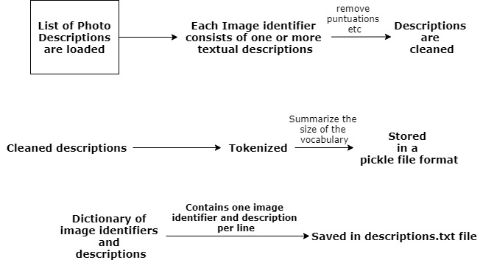
DETAILED METHODOLOGY

Slide 15
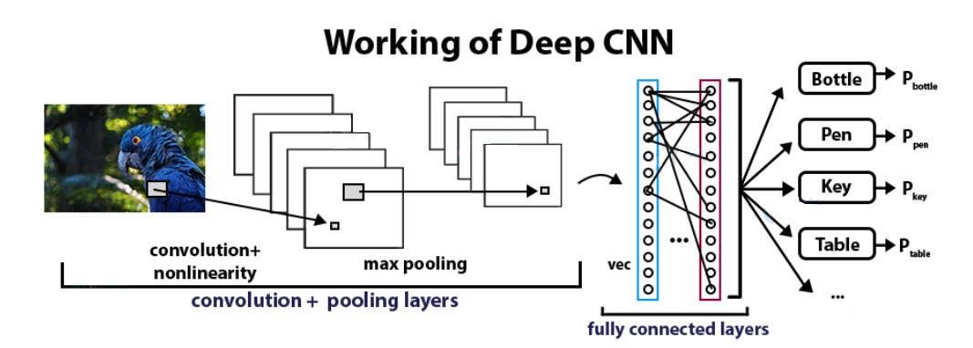
DETAILED METHODOLOGY
3. Convolutional Neural Networks
CNN Algorithm – With the help of CNN Algorithm, features are extracted from the images with the help of pre-trained VGG16 model.
CNN Algorithm is being used in this project as they are specialized deep neural networks which can process the data that has input shape like a 2D matrix. Images are easily represented as a 2D matrix and CNN is very useful in working with images.

Slide 16
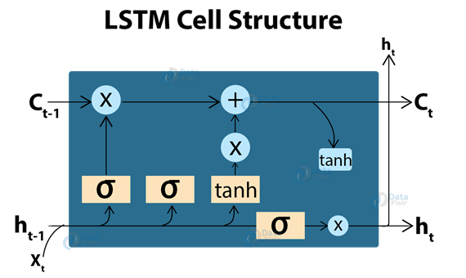
DETAILED METHODOLOGY
4. LSTM (Long Short Term Memory)
LSTM Algorithm – With the features being extracted from the images with the help of CNN Algorithm, they are now fed into the LSTM model which will be responsible for generating the image captions.
LSTM (Long Short Term Memory) is a type of RNN which is well suited for sequence prediction problems. With the help of LSTM, it can predict what the next word will be. LSTM will use the information from CNN to help generate a description of the image.

Slide 17
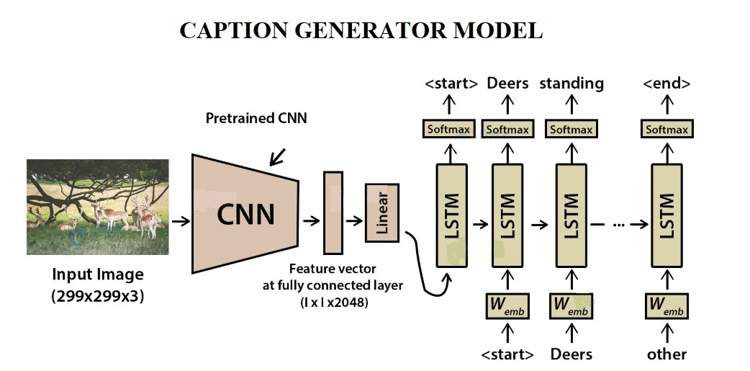
5. Model Generation

Slide 18
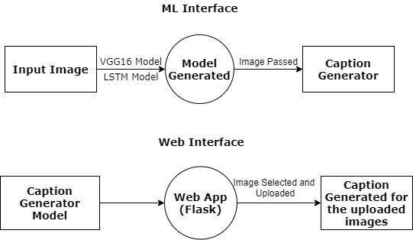
Design diagrams
DFD

Slide 19
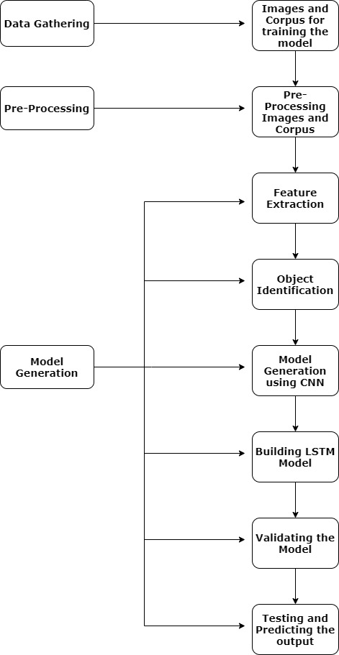
Process Flow Diagram

Slide 20
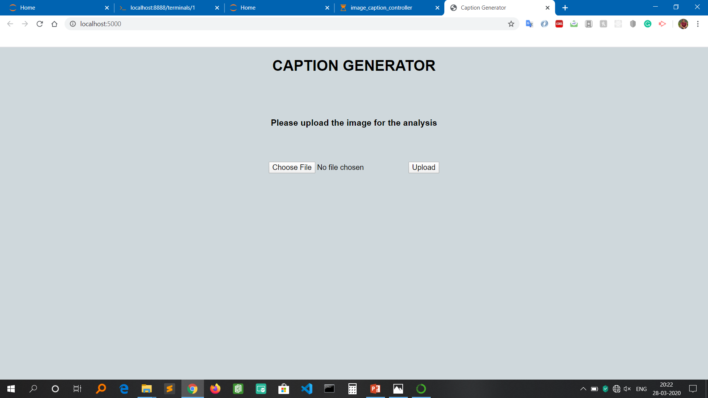
IMPLEMENTATION
HOMEPAGE

Slide 21
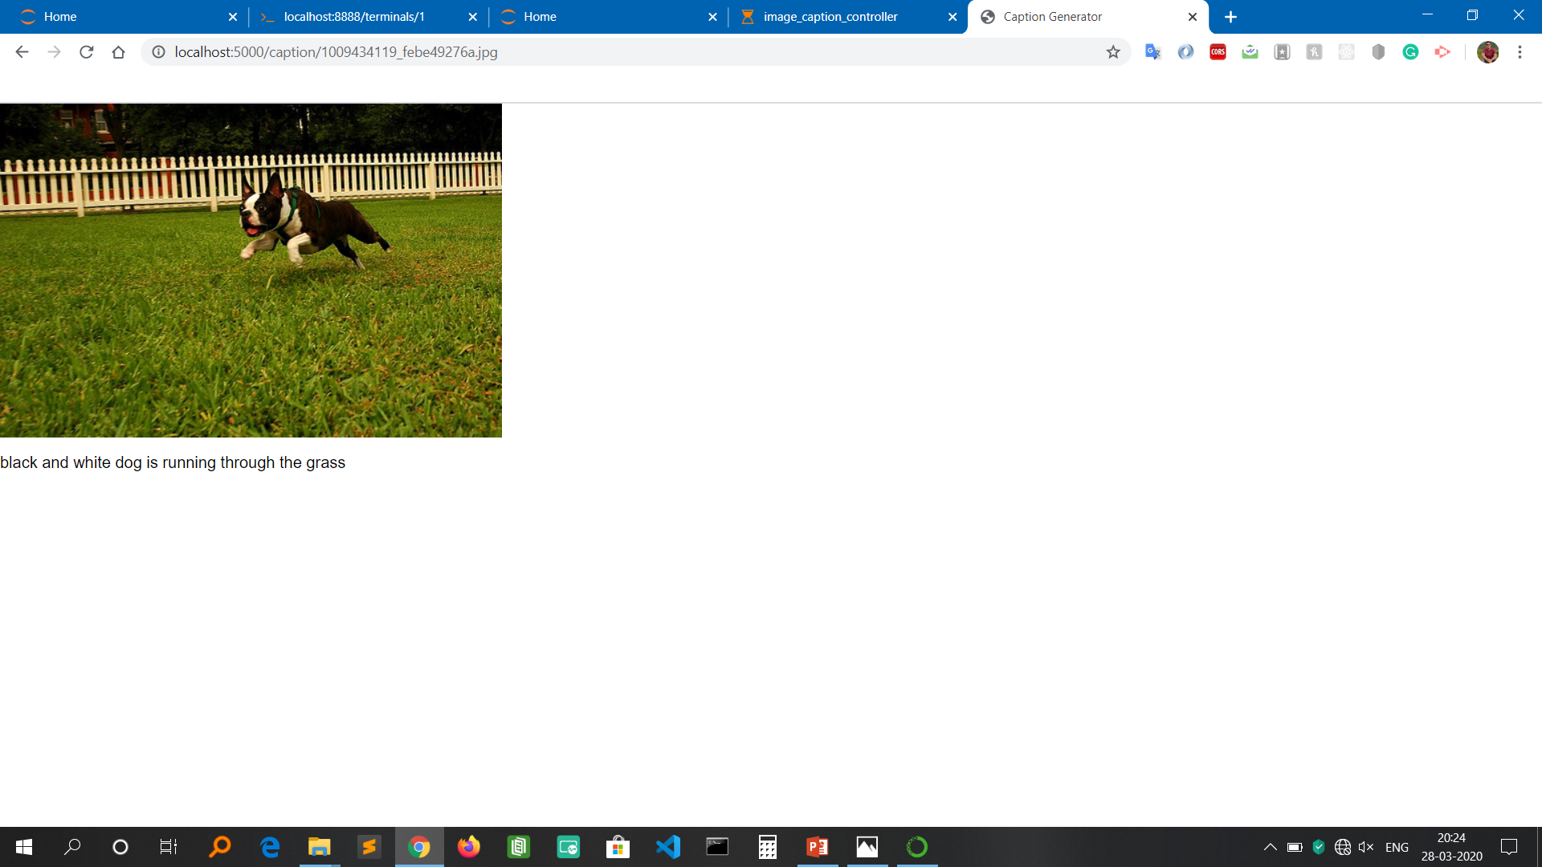
RESULT

Slide 22
APPLICATION IN THE REAL WORLD
If the caption is converted to speech it will be helpful for the visually impaired person
Auto subtitling

Slide 23
Progress
Data Gathering
Flickr_8K dataset – For this project, Flickr_8K dataset is being used as other big datasets like Flickr_30K and MSCOCO datasets can take weeks just to train the network.
Web user interface created
Pre-processing done
Features extracted from images
Object identification done
Model Generated using CNN
Built LSTM model for Caption Generation
Validated the model using BLEU Score
Deployed the ML Model into the web application

Slide 24
THANK YOU

